Slide 1

Cyclistic Bike Share
Analysis of member vs casual riding patterns
Presented by: Mariana Mytiliños
Last updated: November 27, 2021
Google Data Analytics Professional Certificate Capstone Project

Slide 2
Table of contents
Member vs Casual rides by day of the week
Member vs Casual rides by month
Members vs Casual riders bike type selection
Members vs Casual riders location
Conclusion
Going forward

Slide 3
Objective
Business objective: Maximizing the number of annual members.
Guiding question: How do annual members and casual riders use Cyclistic bikes differently?

Slide 4
Member vs casual rides

Slide 5
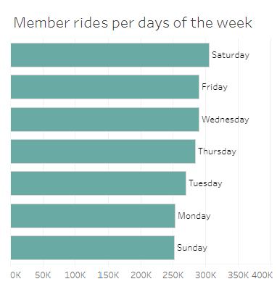
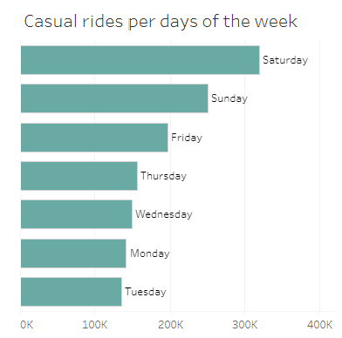
Member and casual rides per day of the week
Figure 1: Member and casual rides per day of the week. Source: Tableau Online.

Slide 6
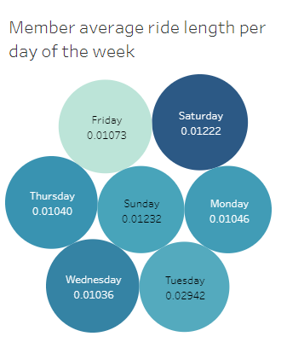
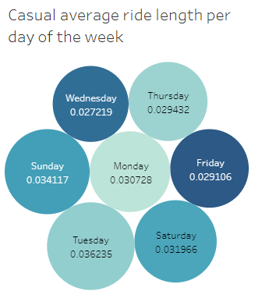
Member and casual average ride length per day of the week
Figure 2: Member and casual average ride length per day of the week. Source: Tableau Online.

Slide 7
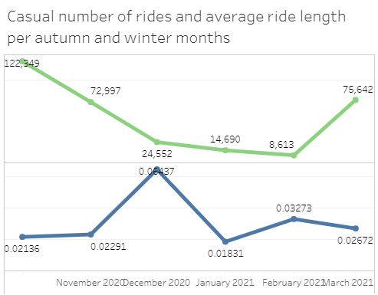
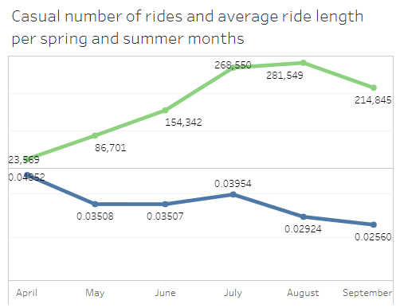
Member and casual rides per spring and summer months
Figure 3: Member and casual number of rides and average ride length per spring and summer months. Source: Tableau Online.

Slide 8
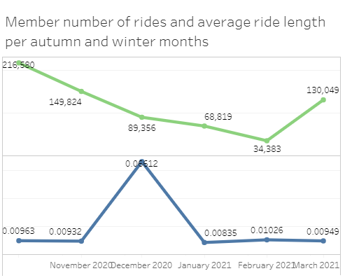
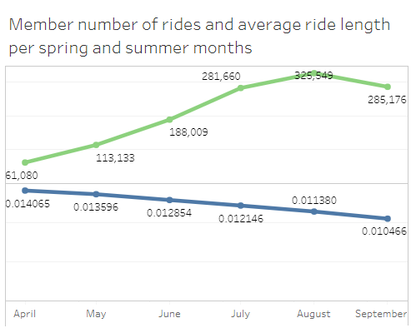
Member and casual rides per autumn and winter months
Figure 4: Member and casual number of rides and average ride length per autumn and winter months. Source: Tableau. Online.

Slide 9
Member vs casual bike type selection

Slide 10
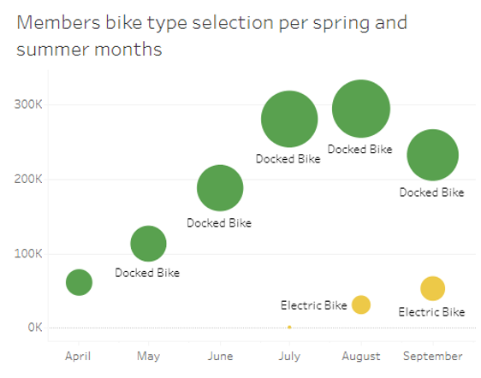
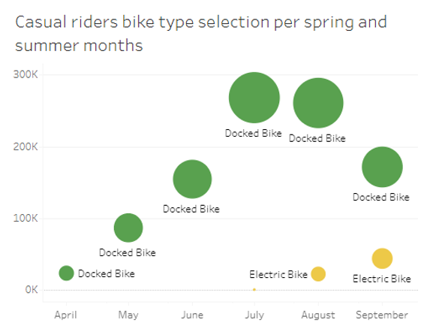
Member and casual bike type selection for spring and summer months
Figure 5: Member and casual bike type selection per spring and summer months. Source: Tableau Online.

Slide 11
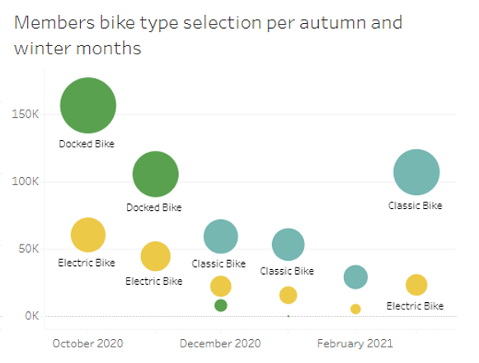
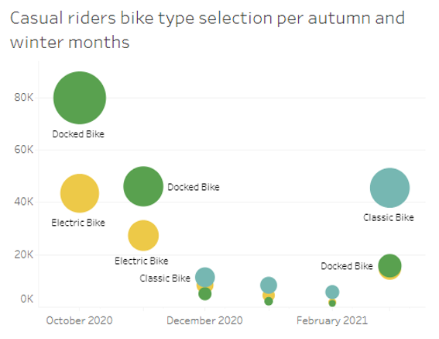
Member and casual bike type selection for autumn and winter months
Figure 6: Member and casual bike type selection per autumn and winter months. Source: Tableau Online.

Slide 12
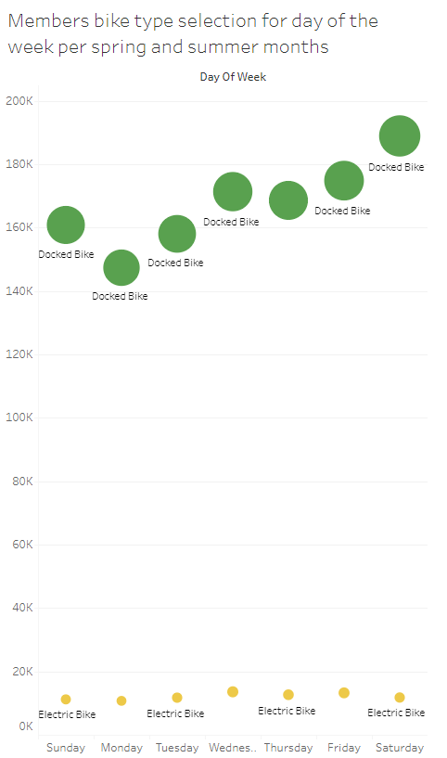
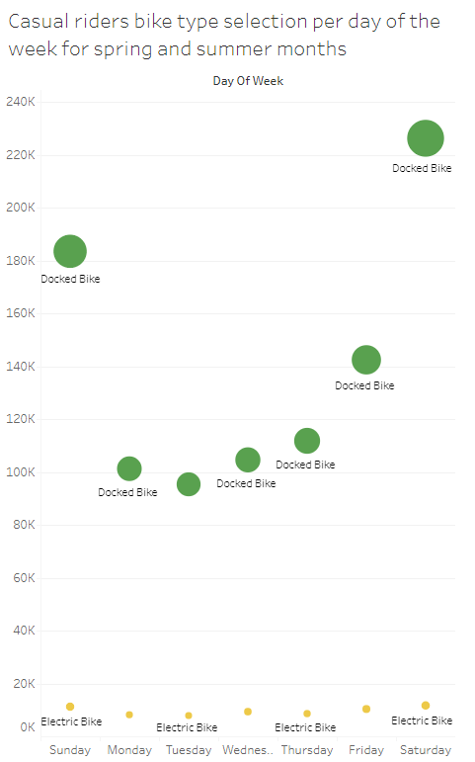
Figure 7: Member and casual bike type selection per day of the week for spring and summer months. Source: Tableau Online.

Slide 13
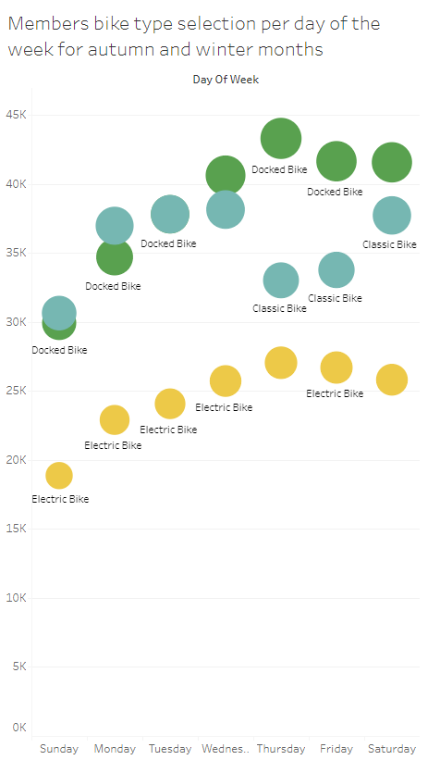
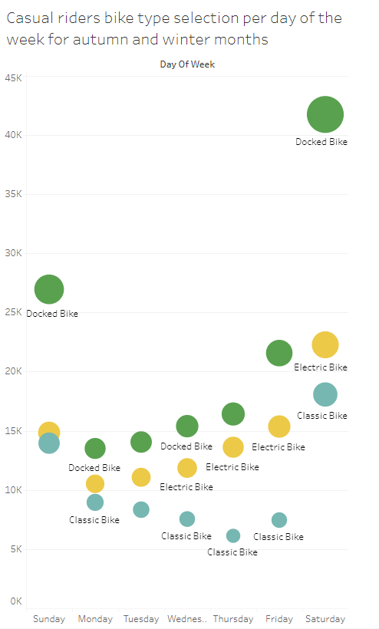
Figure 8: Member and casual bike type selection per day of the week for autumn and winter months. Source: Tableau Online.

Slide 14
Member vs casual rides top start stations

Slide 15
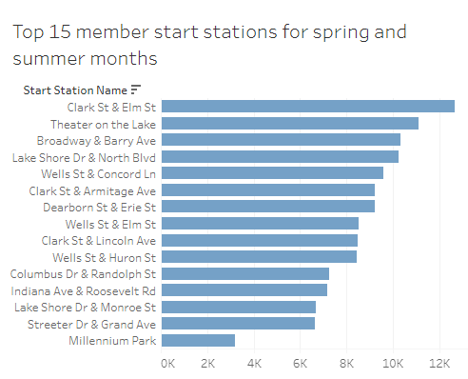
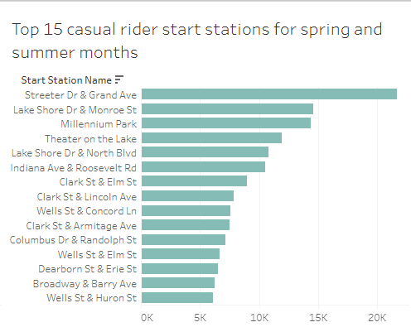
Member and casual top 15 start stations for spring and summer months
Figure 9: Member and casual top 15 start stations for spring and summer months. Source: Tableau Online.

Slide 16
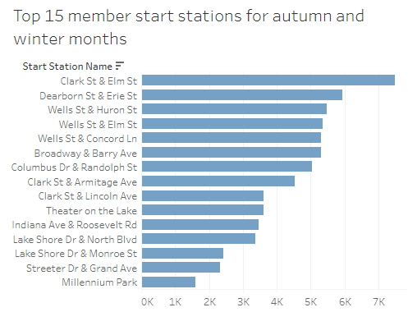
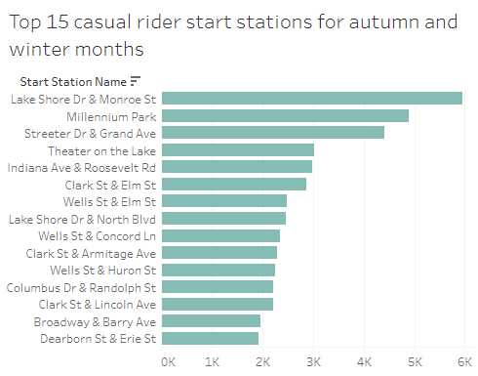
Member and casual top 15 start stations for autumn and winter months
Figure 10: Member and casual top 15 start stations for autumn and winter months. Source: Tableau Online.

Slide 17
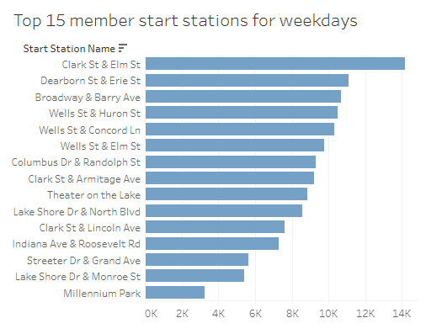
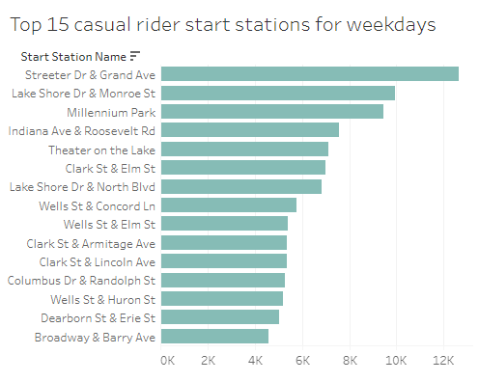
Member and casual top 15 start stations for weekdays
Figure 11: Member and casual top 15 start stations for weekdays. Source: Tableau Online.

Slide 18
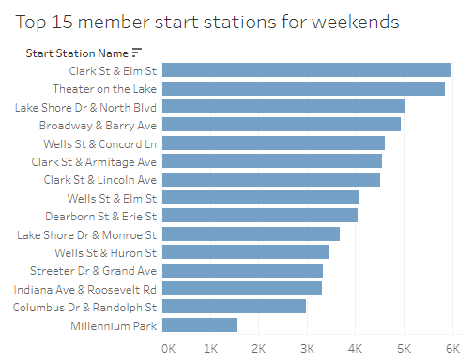
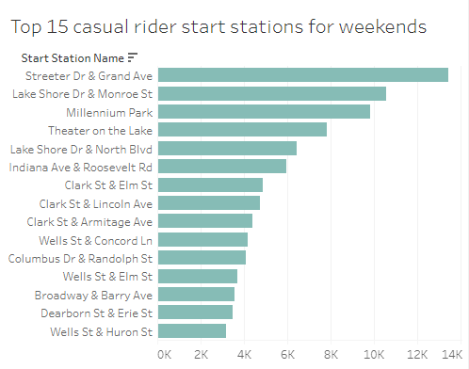
Member and casual top 15 start stations for weekends
Figure 12: Member and casual top 15 start stations for weekends. Source: Tableau Online.

Slide 19
Conclusions
Common characteristics between members and casual riders:
Similar distribution of rides through the different months of the year.
Peak average ride length in December.
Almost the same bike selection pattern in spring and summer months.
Same top 15 start stations for all months, weekdays and weekends.

Slide 20
Conclusions
How do annual members and casual riders use Cyclistic bikes differently?
Casual riders ride less in autumn and winter months.
Casual riders tend to ride more on weekends.
Casual riders have longer average ride lengths than members.
Casual riders have a higher selection of electric bikes.
The top 3 most frequented start stations for casual riders tend to be at the bottom of the top 15 most frequented start stations for members.

Slide 21
Proposed actions
Targeting advertising campaigns, actions and promotions.
Cyclistic marathons.
Cyclistic winter holiday campaigns.
Cyclistic app.
Enhancing the fleet of electric bikes.

Slide 22
Thank you.

Slide 23
Appendix
Tableau dashboards

Slide 24
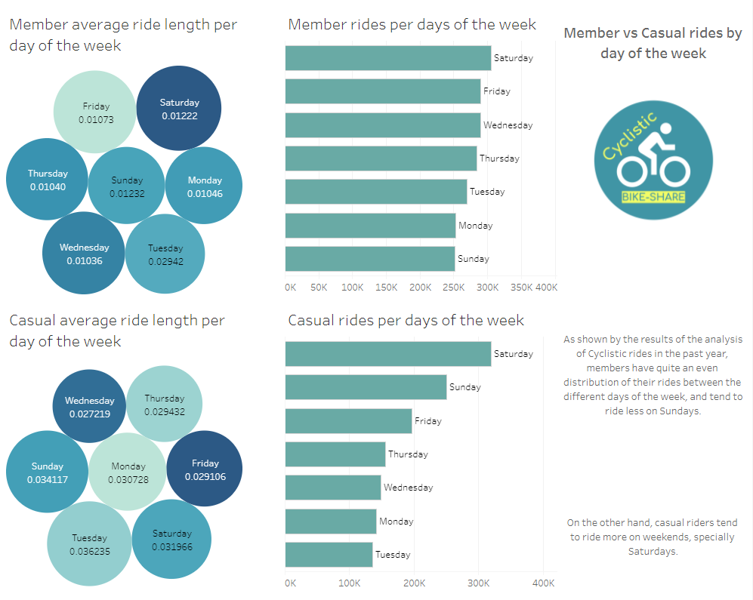

Slide 25
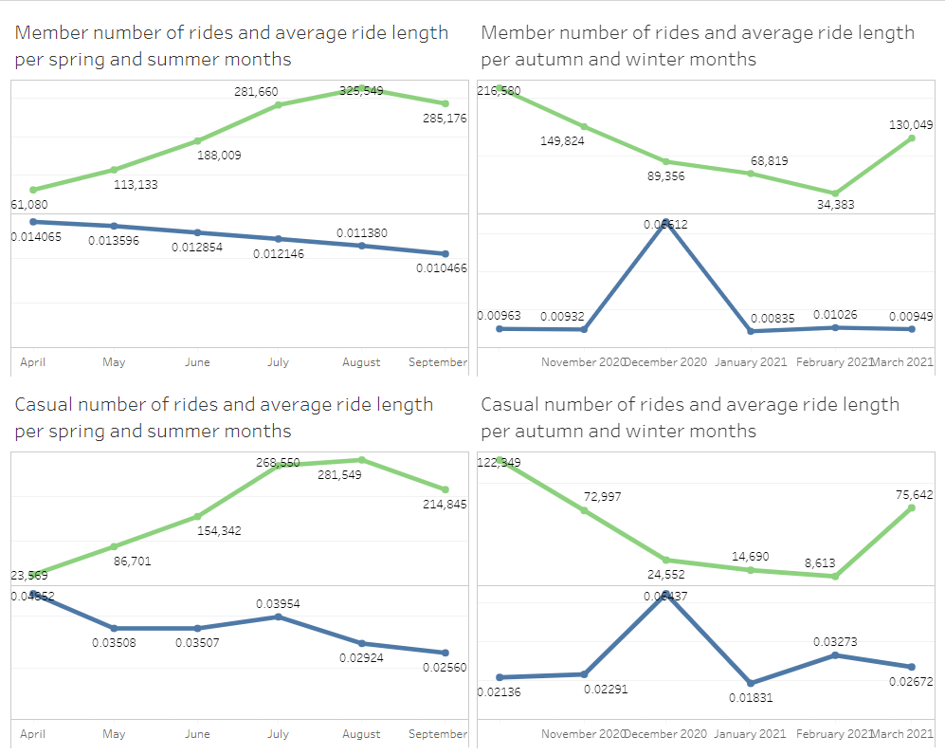

Slide 26
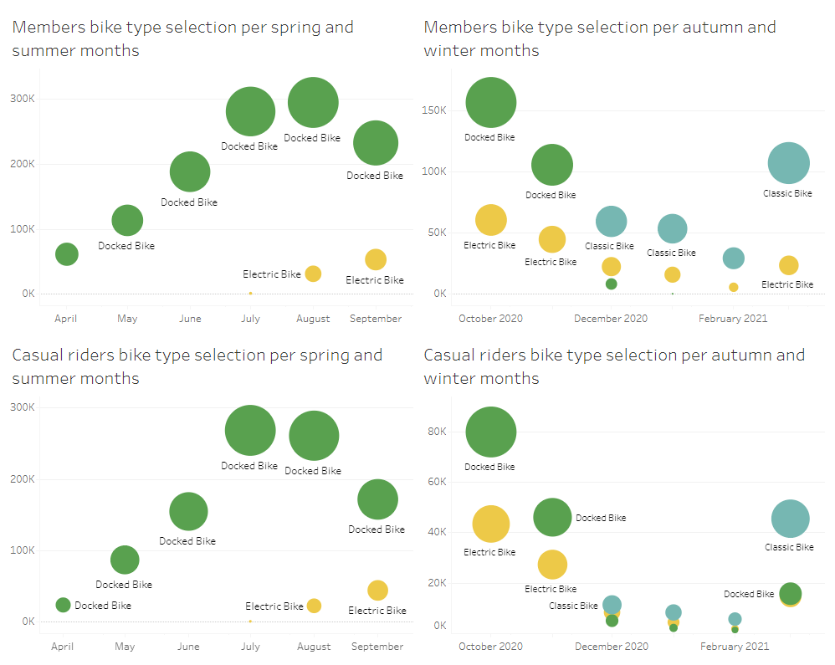

Slide 27
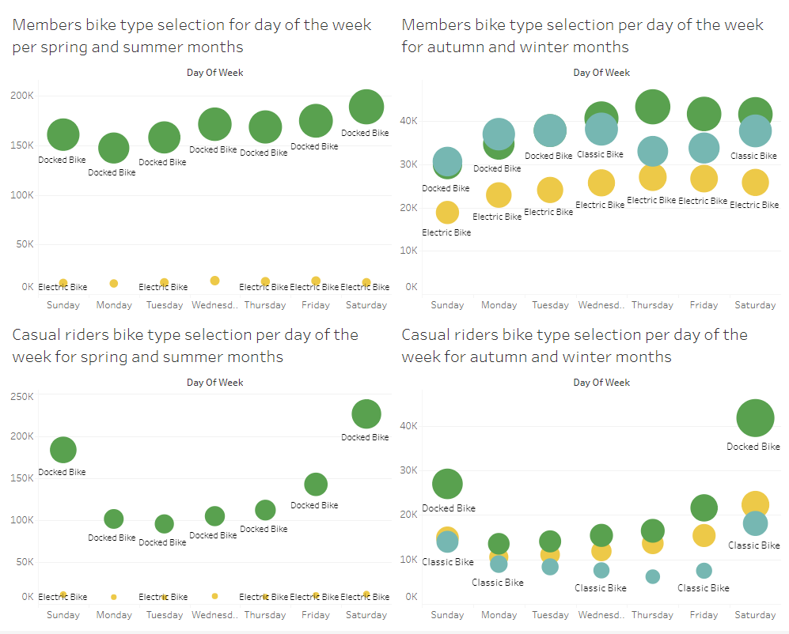

Slide 28
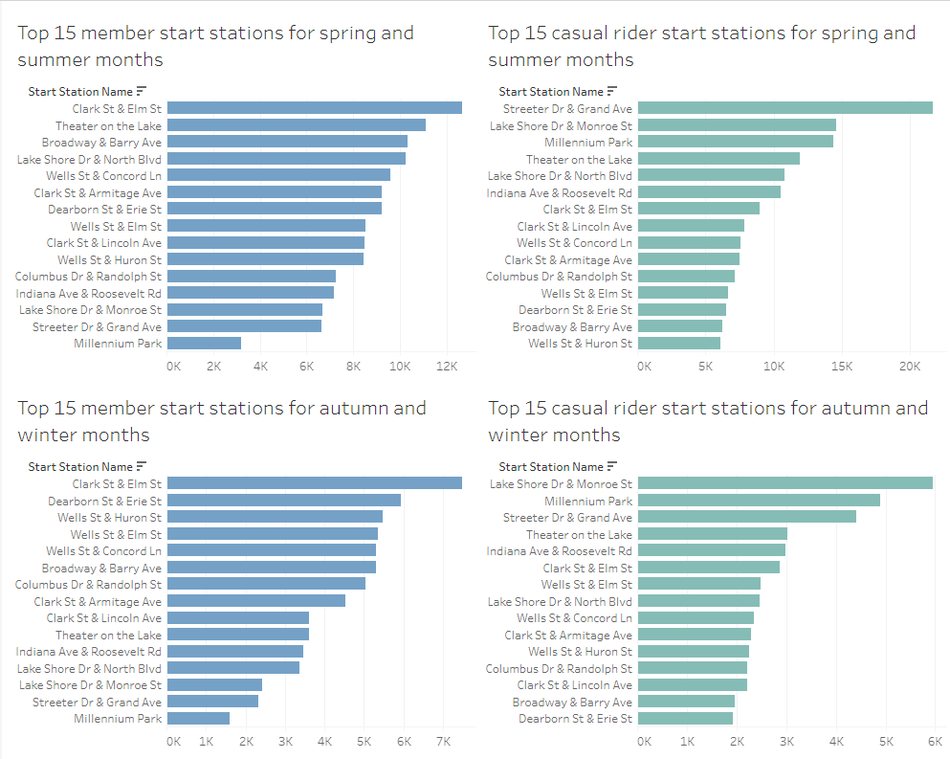

Slide 29
